Slide 1
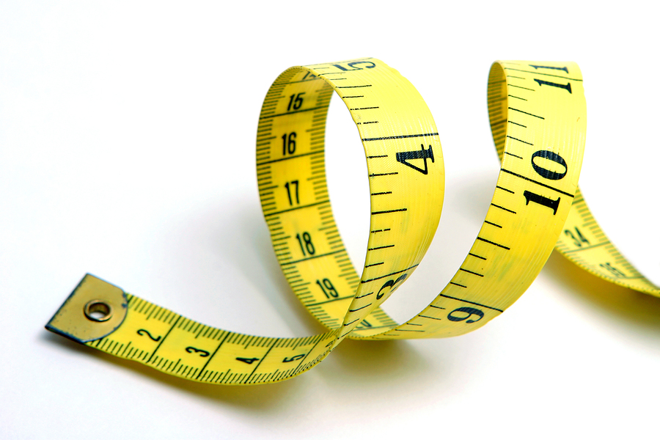
Ordering Decimals
EQ: How does place value relate to decimals?

Slide 2
Ordering Decimals
EQ: How does place vaue relate to decimals
Starter: What place value is the underlined digit?
4.268 64.18 4.106 65.832 5.134

Slide 3
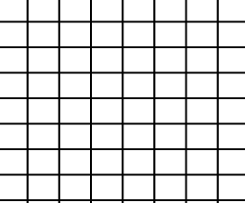

Examples...
1. Put the decimals in order from smallest to largest:
3 | 20.5 | 10.5 | 3.5 | 7.5
T U $\frac{1}{10}$ $\frac{1}{100}$

Slide 4

Examples...
2. Put the decimals in order from smallest to biggest:
3.27 | 32.7 | 3.07 | 3.72 | 27.3
T U $\frac{1}{10}$ $\frac{1}{100}$

Slide 5
ORDERING DECIMALS
TASK
1) List the following numbers in ascending order.
0.6, 0.23, 0.8, 0.1 ……………………
4, 0.7, 3.6, 1.9 ……………………
1.43, 1.5, 1.7, 1.099 ……………………
0, 1.0, 0.87, 1.25 ……………………
1.09, 1.90, 1.11, 1.2 ……………………
(f) 0.420, 0.4 0.415, 0.48, 0.469
............................................................
(g) 0.08, 0.25, 0.81, 0.2, 0.68
................................................
(h) 0.507, 0.75, 0.5, 0.078
................................................
(I) 14.2, 0.93, 1.2, 5.01
....................................................
(j) 0.92, 0.901, 0.99, 0.099, 0.909
...................................................
(k) 4.2, 0.42, 0.024, 0.93, 0.039
...........................................................
Notes:
5

Slide 6
ORDERING DECIMALS
TASK
1) List the following numbers in ascending order.
0.6, 0.23, 0.8, 0.1
4, 0.7, 3.6, 1.9
c) 1.43, 1.5, 1.7, 1.099
d) 0, 1.0, 0.87, 1.25
e) 1.09, 1.90, 1.11, 1.2
1.09, 1.11, 1.2, 1.90
(f) 0.420, 0.4 0.415, 0.48, 0.469
0.4, 0.415, 0.420, 0.469, 0.48
(g) 0.08, 0.25, 0.81, 0.2, 0.68
0.08, 0.2, 0.25, 0.68. 0.80
(h) 0.507, 0.75, 0.5, 0.078
0.078, 0.5, 0.507, 0.75
(I) 14.2, 0.93, 1.2, 5.01
0.93, 1.2, 5.01, 14.2
(j) 0.92, 0.901, 0.99, 0.099, 0.909
0.099, 0.901, 0.909, 0.92, 0.99
(k) 4.2, 0.42, 0.024, 0.93, 0.039
0.024, 0.039, 0.42, 0.93, 4.2
0.1, 0.23, 0.6, 0.8
0.7, 1.9, 3.6, 4
1.099, 1.43, 1.5, 1.7
0, 0.87, 1.0, 1.25
Notes:
6

Slide 7
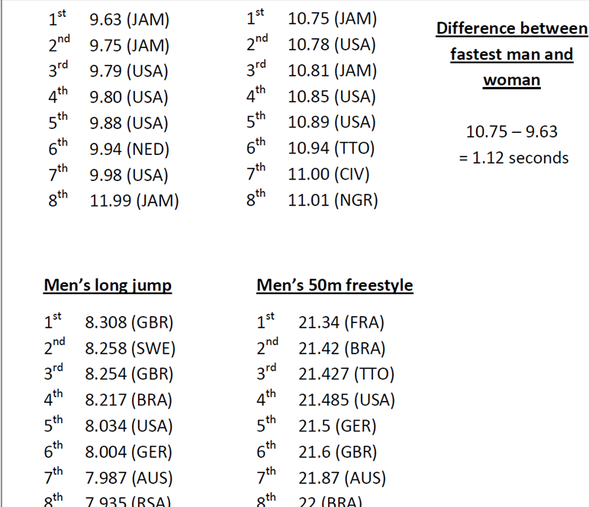
Women’s 100m sprint
Men’s 100m sprint
Extension
10.78 10.775 to 10.785
10.94 10.935 to 10.945
11.00 10.995 to 11.005

Slide 8
ORDERING DECIMALS
TASK
1)
(a) 0.6, 0.23, 0.8, 0.1 ………………………………………
(b) 4, 0.7, 3.6, 1.9 ………………………………………
(c) 1.43, 1.5, 1.7, 1.099 ………………………………………
(d) 0, 1.0, 0.87, 1.25 ………………………………………
(e) 1.09, 1.90, 1.11, 1.2 ………………………………………
0.1, 0.23, 0.6, 0.8
0.7, 1.9, 3.6, 4
1.099, 1.43, 1.5, 1.7
0, 0.87, 1.0, 1.25
1.09, 1.11, 1.2, 1.90
Notes:
8

Slide 9
Put these lengths in order, from shortest to longest.
SNAKE | LION | ELEPHANT
1) 4.2m 4m 2.9m | 1) 6.6m 6.33m 6.58m | 1) 5.5m 55cm 555cm
2) 20m 201cm 22m | 2) 3.21m 2.3cm 90mm | 2) 4.33cm 3.68m 3.69cm
3) 12.4m 21.4m 4.12m | 3) 2.4m 2.39m 2.399m | 3) 9.2m 9.9m 9.09m
4) 6.6m 6.33m 6.58m | 4) 5.5m 55cm 555cm | 4) 6.11m 6.12cm 61.12cm
5) 3.21m 2.3cm 90mm | 5) 4.33cm 3.68m 3.69cm | 5) 2.11cm 2.4cm 2.32cm
6) 2.4m 2.39m 2.399m | 6) 9.2m 9.9m 9.09m | 6) 5.6cm 5.61m 5.55m

Slide 10
For each question, put the decimals in order from smallest to largest.
Snake | Lion | Elephant
1) 1.5 1.8 1.4 | 1) 4.43 4.3 4.40 | 1) 7.41 74.01 7.39
2) 5.32 4.99 5.2 | 2) 6.2 06.22 6.26 | 2) 12.41 12.53 12.11
3) 4.3 4.22 4.2 | 3) 13.57 1.41 14.04 | 3) £14.11 £14.09 £14.63
4) £1.42 £1.64 £1.46 | 4) £2.31 £2.39 £2.41 | 4) £0.09 8p £1.03
5) £3.20 £2.34 230p | 5) £19.21 £19.52 £20.14 | 5) £7.22 740p £7.20
6) £11.32 £11.24 £12.01 | 6) 210p £2.01 £2.11 | 6) £99.12 £99.00 £99.49

Slide 11
PLENARY
Can you order the following measurements in ascending order:
124cm 0.75m 65mm 1.4m 1.1km

